Slide 1
Gesture Recognition Using the Praxis Dataset
Literature Review and Discussion of Current Results
Rahat Islam
Faculty of Engineering
August 3rd, 2021

Slide 2
Agenda
Literature Review of- PRAXIS: Towards automatic cognitive assessment using gesture recognition
Discussion of own experiments and results

Slide 3
PRAXIS: Towards automatic cognitive assessment using gesture recognition
[1]Farhood Negin, Pau Rodriguez & et.(2018). PRAXIS: Towards automatic cognitive assessment using gesture recognition. Expert Systems with Applications, Volume 106, Pages 21-35.

Slide 4
The Praxis Test
The Praxis test is a gesture-based diagnostic test to detect cortical pathologies
Test is often skipped because of the time it takes to evaluate the test and look at the test results from an objective point of view
The paper proposes a framework which could be used to automate the praxis test using machine learning tactics and decision trees.

Slide 5
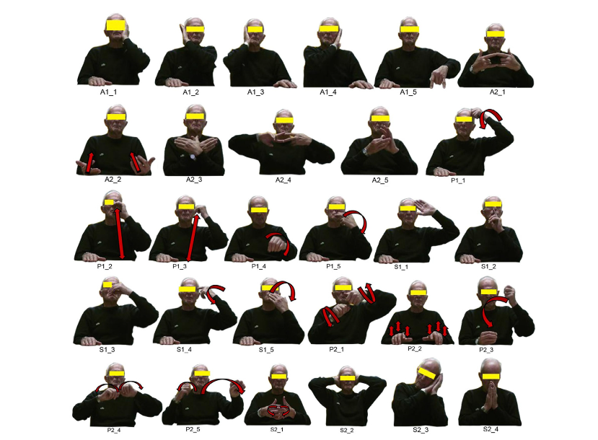
Types of actions in the Praxis Dataset
Static
Dynamic
[1]Farhood Negin, Pau Rodriguez & et al., “PRAXIS: Towards Automatic Cognitive Assessment Using Gesture Recognition” in Expert Systems with Applications, 2018, vol 106, pp 21-35.

Slide 6
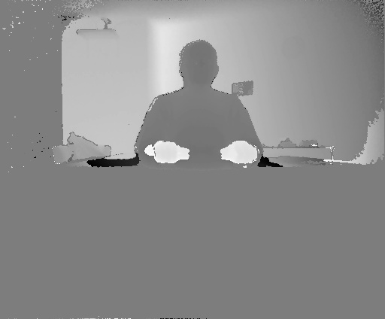
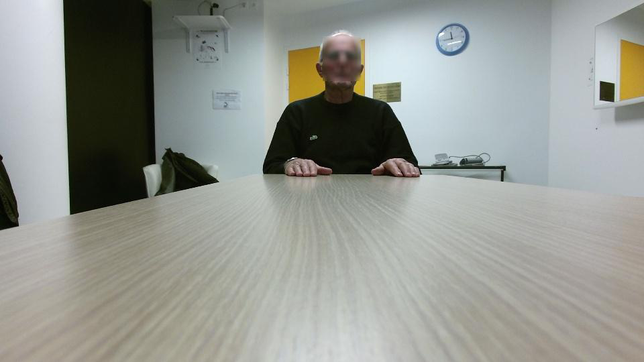
Types of Data Available From the Praxis Dataset
[1]Farhood Negin, Pau Rodriguez & et al., “PRAXIS: Towards Automatic Cognitive Assessment Using Gesture Recognition” in Expert Systems with Applications, 2018, vol 106, pp 21-35.

Slide 7
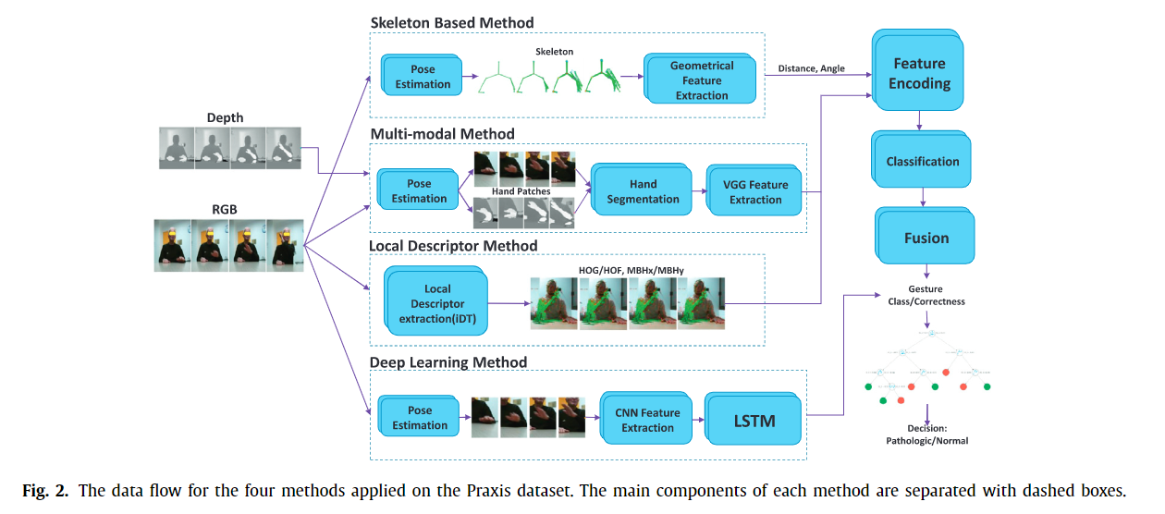
Proposed Methodologies Used In Gesture Recognition
[1]Farhood Negin, Pau Rodriguez & et al., “PRAXIS: Towards Automatic Cognitive Assessment Using Gesture Recognition” in Expert Systems with Applications, 2018, vol 106, pp 21-35.

Slide 8
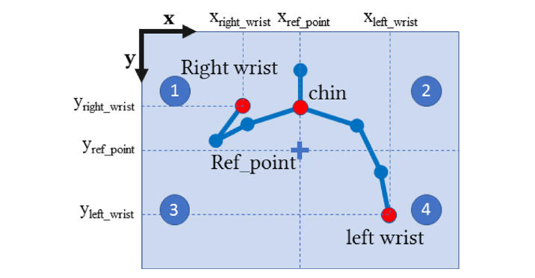
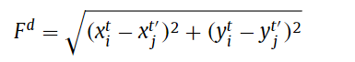
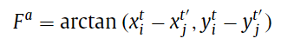
Skeleton Based Method
X-Y coordinates are converted into Euclidean distances and polar coordinates
SVM classifier is used in the end for classification
[1]Farhood Negin, Pau Rodriguez & et al., “PRAXIS: Towards Automatic Cognitive Assessment Using Gesture Recognition” in Expert Systems with Applications, 2018, vol 106, pp 21-35.

Slide 9
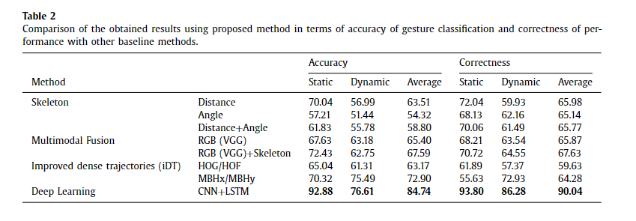
Results
[1]Farhood Negin, Pau Rodriguez & et al., “PRAXIS: Towards Automatic Cognitive Assessment Using Gesture Recognition” in Expert Systems with Applications, 2018, vol 106, pp 21-35.

Slide 10
Personal Experiment Objective: Developing a model using skeletal data which out-performs the original paper’s accuracy
Accuracy to beat: 90.04%(DLP), 65.98%(Skeletal)

Slide 11
Data Pre-processing
Crop out skeletal Data so that upper body joints are only included
Group individual frames of the actions to provide sequential data(35 timestamps used)
Dataset contains 29 actions performed by each of the 58 patients.
Data is split into 3 folds (Patients: 1 – 16, 17 – 37, 38 – 58)
Each fold will be used for 3-fold cross validation (training, validation, testing)

Slide 12
Model Used
Model is first used to classify static and dynamic images separately, and the total accuracy is the average of the two accuracies
Batch Size = 128, timesteps = 35
Single Classification Model
(128, 64, 16)
(128, 64, 256)
(128, 256)
(128, 256)
(128, 256)
Input
LSTM
LSTM
Batch Normalization
Dropout
Dense
(relu)
(128, 512)
Output
Dense
(SoftMax)
Batch Normalization
Dense
(relu)
Dropout
Dense
(relu)
(128, 15)
(128, 512)
(128, 512)
(128, 1024)
(128, 1024)
Loss Function: categorical cross entropy
Optimizer: Adam(Learning Rate = 0.0001)
Notes:
Add units

Slide 13
Preliminary Results
Fold Used For Training
Fold 1 | Fold 2 | Fold 3 | Average
0.518 | 0.556 | 0.532 | 0.535
0.491 | 0.545 | 0.496 | 0.511
0.505 | 0.551 | 0.514 | 0.523
Static accuracy
Dynamic accuracy
Average accuracy

Slide 14
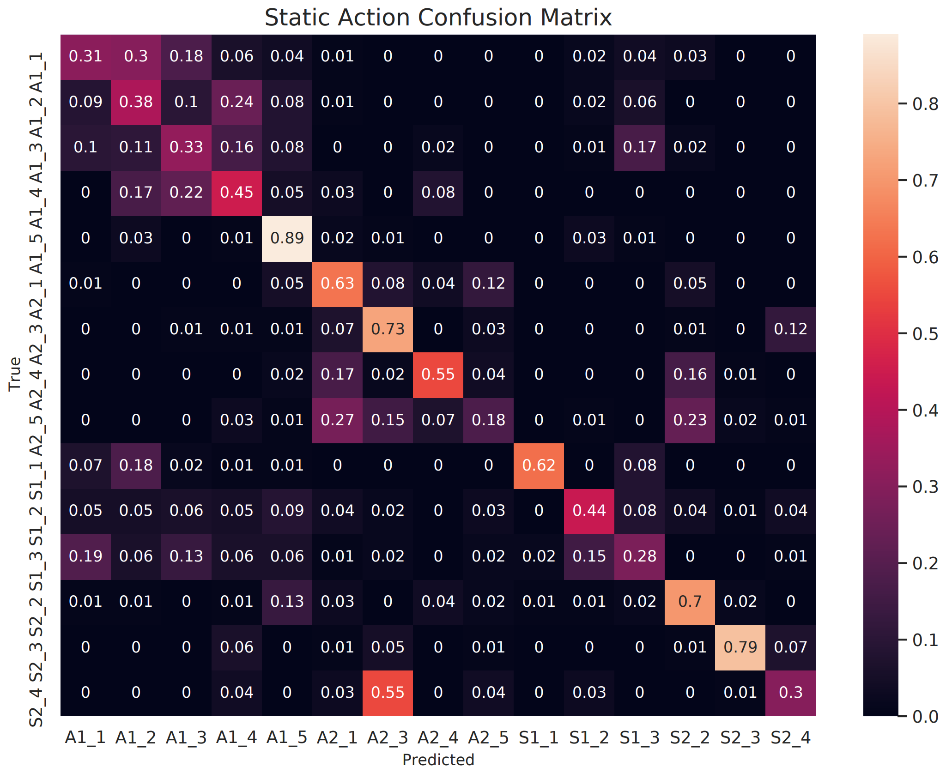
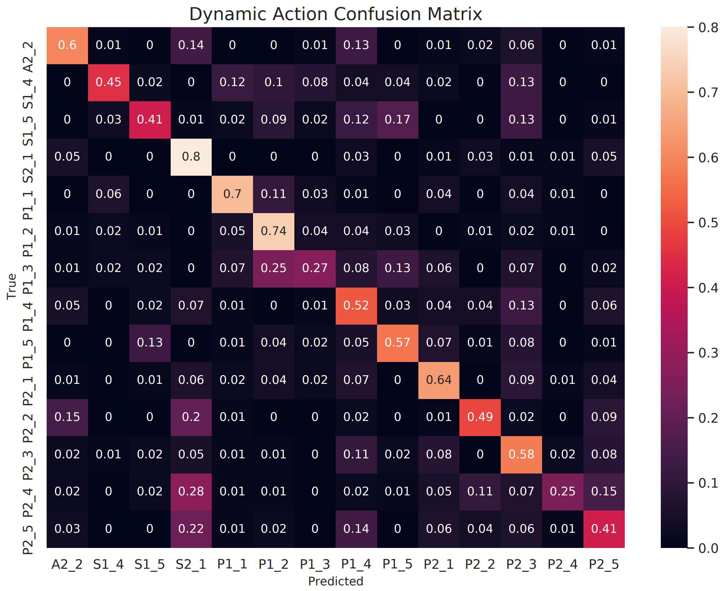
Confusion Matrices

Slide 15
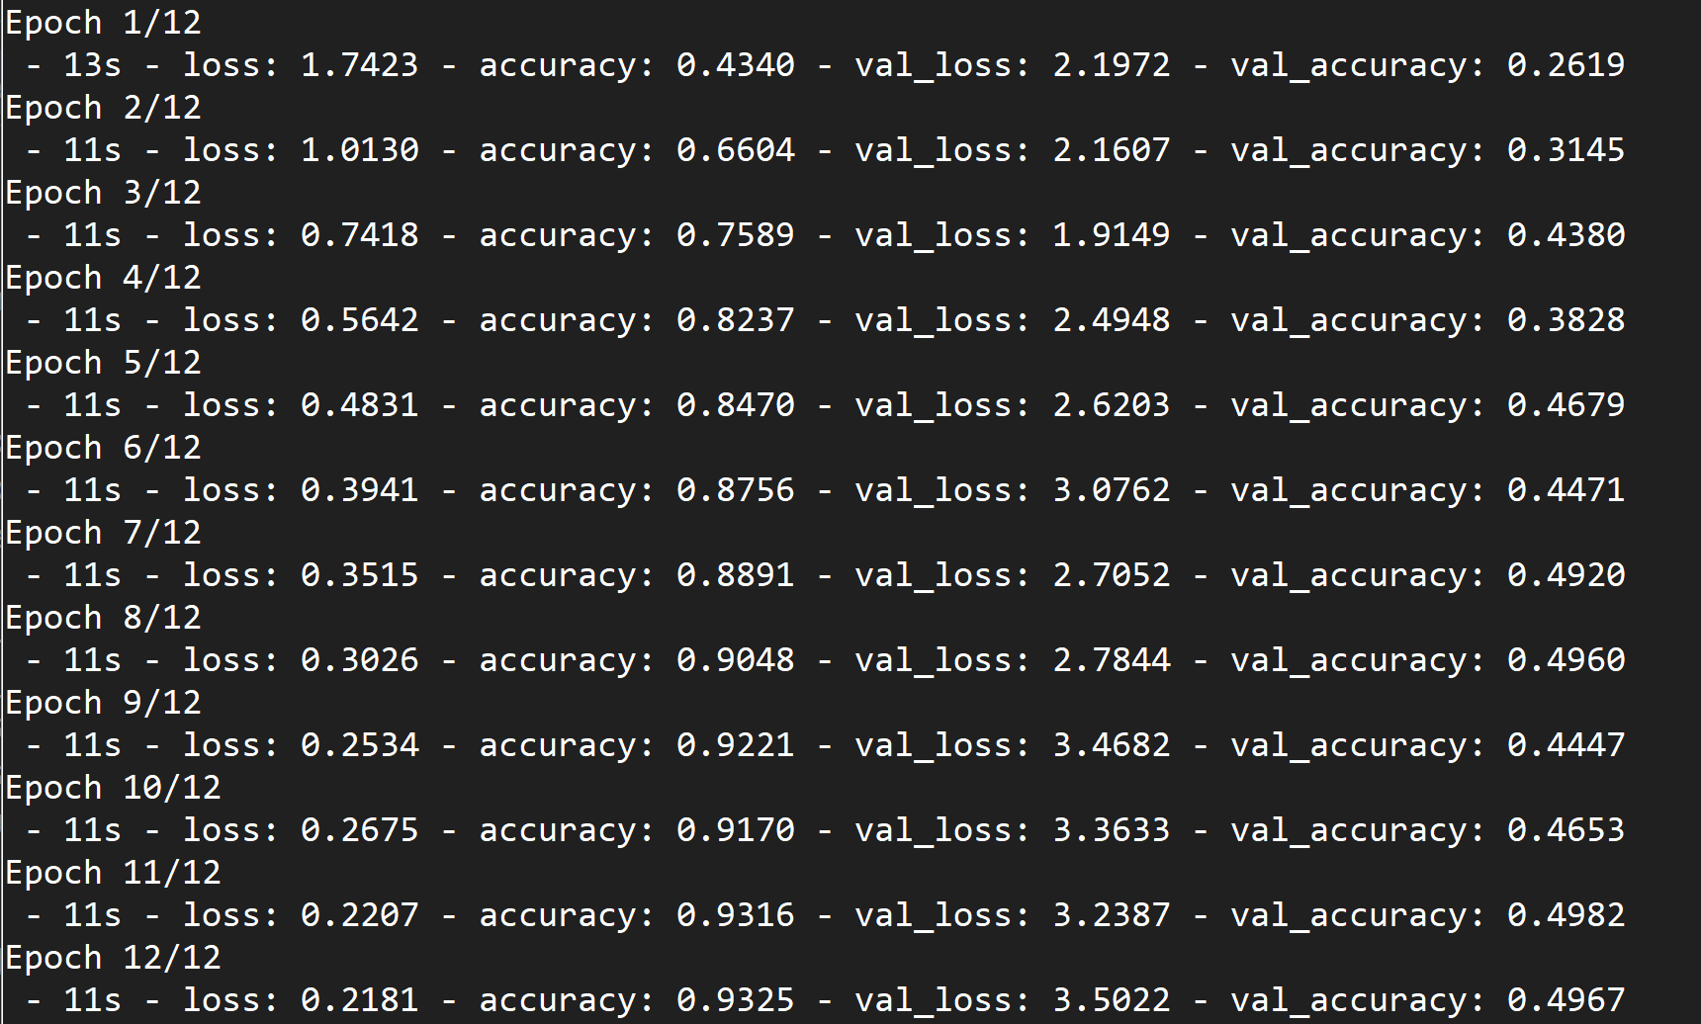
Work to be done
Address overfitting issues seen during training
Look at better refinements in pre-processing of data
Explore more deep learning models (ex. Temporal Convolutional Networks)

Slide 16
References
[1]Farhood Negin, Pau Rodriguez & et al., “PRAXIS: Towards Automatic Cognitive Assessment Using Gesture Recognition” in Expert Systems with Applications, 2018, vol 106, pp 21-35.
Notes:
Proper IEEE references

